Slide 1
Studying the Past-points to consider
Why do we primarily look at CHANGES when we learn about history?
Certain events in human history are just more important than others, because they cause profound changes in human life. These are sometime referred to as “marker events” in human history.
Can you think of some “marker events” from human history? What makes them important?
Why do we have to pay attention to perspective when we learn about history?

Slide 2
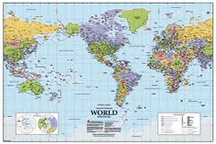
Can you spot it?
Can you spot the point-of-view expressed in this map?
How can something as “factual” as a map still show be colored by perspective?

Slide 3
Peopling the Planet
How did we end up (almost) everywhere?

Slide 4
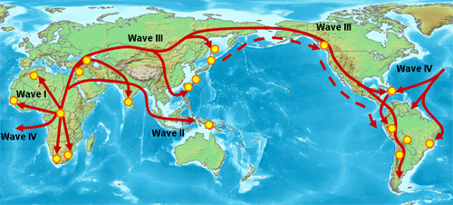
From Africa to…
Asia, Austronesia & Europe
The Americas

Slide 5
The Push-Pull Factors of Migration Push…
Why do people move?
Push factors encourage people to LEAVE their home:
climate- prolonged droughts, harsh winters, flooding or other inhospitable conditions can PUSH people to leave.
Did Siberia get too cold for ancient Americans?
Personal safety- if an area becomes too dangerous to live in, people will leave.
Did attacks by other tribes PUSH people out of Africa and into Asia?
What would motivate one tribe to attack another?
Cost-of-living- if it becomes too difficult or expensive to live in a place, people move away.
Did the herds Siberian people depended on leave the area, making it difficult to find food, clothing and shelter?
Can something be “expensive” even if it doesn’t cost money?
(paying with your time, your effort, your life…)
PONDER this: If Europe was so inhospitable, why would people move there?

Slide 6
…or pull?
Pull factors-encourage people to leave their home by convincing them that some other place is better than the place they are living now. These reasons are not based on experience, but on perception, usually based on what the emigrant has heard or read about the “new” place.
Pull factors can include social, economic, political and physical conditions of the “new” place, all of which the emigrant expects to be better than his “old” home.
Do you think the tribes living in Indonesia heard of a “new” home across the sea in Australia and decided to move there?
JOURNAL RESPONSE QUESTION: What factors led prehistoric people to migrate to new places? SHORT ESSAY.
*immigrant vs. emigrant: an immigrant is person who is living in a new country.
An emigrant is someone who is moving away from his own country to another country. When you are leaving, you are an emigrant, when you arrive, you are an immigrant. You are a migrant if you are continually moving from place to place.

Slide 7
To Migrate, or Not to Migrate, that is the Question…
Sometimes, there are obstacles that block people from migrating from one area to another. These are called intervening obstacles.
Usually these are physical, like giant deserts, glaciers, mountains, or oceans.
Sometimes they can be political, such as warrior tribes that won’t let groups pass undisturbed.
What changes took place 20,000 years ago that altered the intervening obstacles to human migration?
How do humans utilize technology to surpass these intervening obstacles?

Slide 8
Who, Where, When
Humans hung out in Africa for about 150,000 years, developing tools, spiritual beliefs, ritualized behaviors and other things we associate with humans.
100,000 years ago: humans begin moving across southern Asia, where it is relatively warm.
70,000 years ago: humans move into East Asia
60,000 years ago: humans move into Middle East
45,000 years ago: humans move into Europe and Asia.
50,000 years ago: humans move into Australia from Indonesia via boat.
15,000-20,000 years ago: humans move into the Americas (still controversial how long humans have been here. Conservative estimates are around 16,000 years).
3500 years ago: Pacific Islands
1000 years ago: New Zealand

Slide 9
Okay, we’re here. Now what?
As people migrate, they spread their culture to new areas in a process called cultural diffusion.
What fun stuff do we bring with us when we move?
DISEASES
FOOD
CLOTHING
LANGUAGE
TECHNOLOGY
RELIGION
SEEDS (Did you know that pineapples originated in Brazil and spread north into Central America before ending up in Hawaii?)

Slide 10
The Biggest Aha! Moment in Human History-the Agricultural Revolution*
Between 16,000 and 10,000 years ago, humans all over the world began to cultivate cereal grains and domesticate local animals. This started out as a supplement to traditional hunting and gathering, but eventually became the dominant economic activity around the world.
Why did some areas not adopt farming as their principle food source?
*Also called the Neolithic Revolution.

Slide 11
Agriculture Around the World
There are three types of agriculturalists in human prehistory:
Horticulturalists-hand tools only,
small-scale supplemental farming
Agriculturalists-use of animals &
plows to cultivate more crops
-Pastoralists-herding and care of
domesticated animals. It started with wolves and
other wild dogs used for protection & hunting; sheep &
Goats-Southwest Asia, cows-Eurasia & North Africa, water
Buffalo & chicken-China, camels-Arabia, llamas & guinea pigs
-S. America, horses & pigs-Eurasia.
How did we all end up with chickens?
Most agrarian societies utilized a combination of both
farming and pastoralism, although some nomadic pastoral societies did develop in areas that are suitable for animals, but not farming, such as Mongolia.

Slide 12
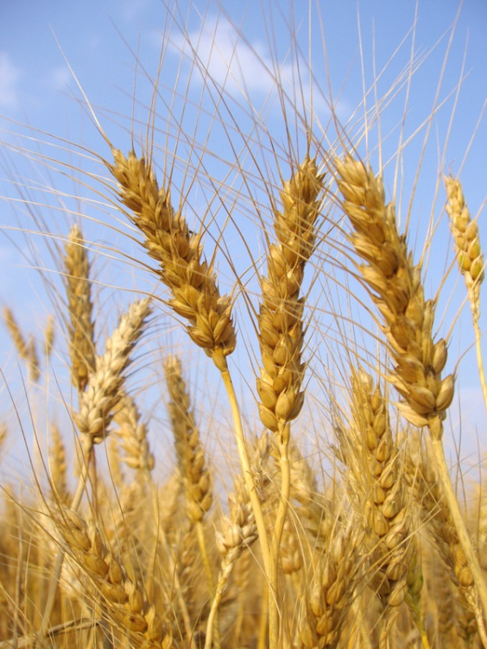
I’m a Farmer and I Grow It…So what?
Why is the Agricultural Revolution important in human history?
Thesis (time, place, 3 SPICE)
Concrete Detail, Commentary, Commentary
Conclusion

Slide 13
And the answer is…
The discovery of agriculture is important because
People settled down: People began to accumulate goods and claim land as their own. This leads to the concept of private property & wealth, which also leads to social inequality.
Specialization: in hunter-gatherer societies there are two jobs-hunter (men), gatherer (women). Clearly, they both did other jobs, too, such as___________________________. However, once people moved into villages, they began to do specific jobs based on their personal talents. This made work more efficient, and also contributed to social inequality, as some tasks were valued more than others. The 3 primary trades then were pottery, metallurgy, and textile production.
Gender inequality: in a hunter-gatherer society, women play a vital role in the survival of the group by gathering a large portion of the food, so they were equal to men in social value. However, as settled life progressed and women lost their economic power (because they no longer filled the role of provider), their status also decreased.
Surplus goods: farming meant more food to be put up, which led to more reliable access to nourishing food and to eventual population growth, which leads to the development of cities, which leads to more complex government systems with specialized government jobs. Specialization meant more goods were produced, as well. With surplus goods and foods available, trade began to flourish.
Religion: Paleolithic people had religions, but these became much more complex as human society urbanized. Religions became much more formal and specialized religious jobs developed. Most agrarian religions were polytheistic, with gods that controlled the aspects of life important to farmers (rain gods, sun gods, fertility gods).
Arts: Although art existed in Paleolithic societies, it became much more complex as societies urbanized. Architecture became much more elaborate and artistic, as did statuary and other art forms.
Written language: Most written languages were originally developed as a way to record trade transactions, which were made possible by the surpluses netted by an agrarian society.
Disease: life was rough as a hunter-gatherer, but you were more likely to die from injury, exposure, or starvation than disease. The advent of agriculture and the settled life it promoted also led to the development and spread of many, many diseases through increased human contact within cities and on trade routes; just a fun sample includes cholera, dysentery, plague, syphilis, measles…I could go on, but who wants to?

Slide 14
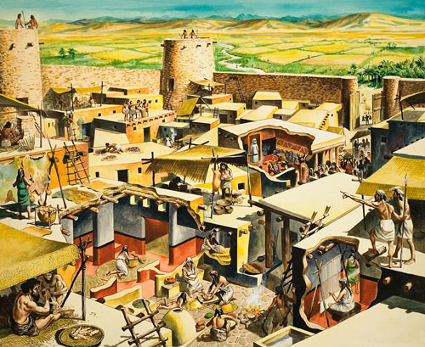
Jericho & Catal Huyuk
What ancient Jericho probably looked like
Two large Middle Eastern towns, both built before 7,000 BCE, are excellent examples of agrarian settlements.
Jericho (Jordan River): large, heavily fortified, trade economy based on the exchange of salt, sulfur, and pitch for semiprecious stones from Anatolia, turquoise from the Sinai Peninsula, and obsidian & cowrie shells from other areas. Farming took place outside of the walled town, which was made of mud-bricks and stone foundations, with a 12’ protection wall around the entire town.
Catal Huyuk (Turkey): also large, it was fortified by building the houses with one continuous outside wall, with no windows or entrances on the outer edge, thus preventing anyone from invading the houses. Farming was also done outside the town, as was much of the trade. They traded flint, obsidian, and jewelry with nearby towns and villages.
What does it tell us about Neolithic urban societies that they traded for “pretty” goods, such as turquoise and jewelry?

